Slide 1


PREMIER LEAGUE PLAYER DATA ANALYSIS
Descriptive, Diagnostic, Predictive & Prescriptive Insights

Slide 2



PROJECT OBJECTIVE & DATASET DESCRIPTION
Dataset contains detailed statistics for all Premier League players.
Total features: 57 columns covering offensive, defensive, and passing metrics.
Each row represents a player.
Objective: Apply all 4 types of analytics to extract actionable insights.

Slide 3

1.Descriptive
APPROACH IN ANALYSIS
What happened?
2.Diagnostic
Why did it happen?
Methodology
Microsoft Excel – Calculated Fields, Charts, Trendlines
Data cleaning & feature selection applied to reduce dimensionality.
Filtered essential columns based on questions and use cases.
Visualizations created for enhanced interpretability.
3.Predictive
What could happen?
4.Prescriptive
What should we do?

Slide 4

DESCRIPTIVE INSIGHTS
1.Univariate
How many players are there in each position?
How many players have scored more than 5 goals?
Who are the top 10 players in terms of assists?
How many players have played more than 2000 minutes?
Who are the players with the most shots on target?
How many players have more than 10 clean sheets?
2.Bivariate
7. What is the average number of goals per nationality?
8. Which club's players have scored the most goals?
9. What is the overall goal distribution by position?
10. What is the pass completion rate (%) for each position?

Slide 5
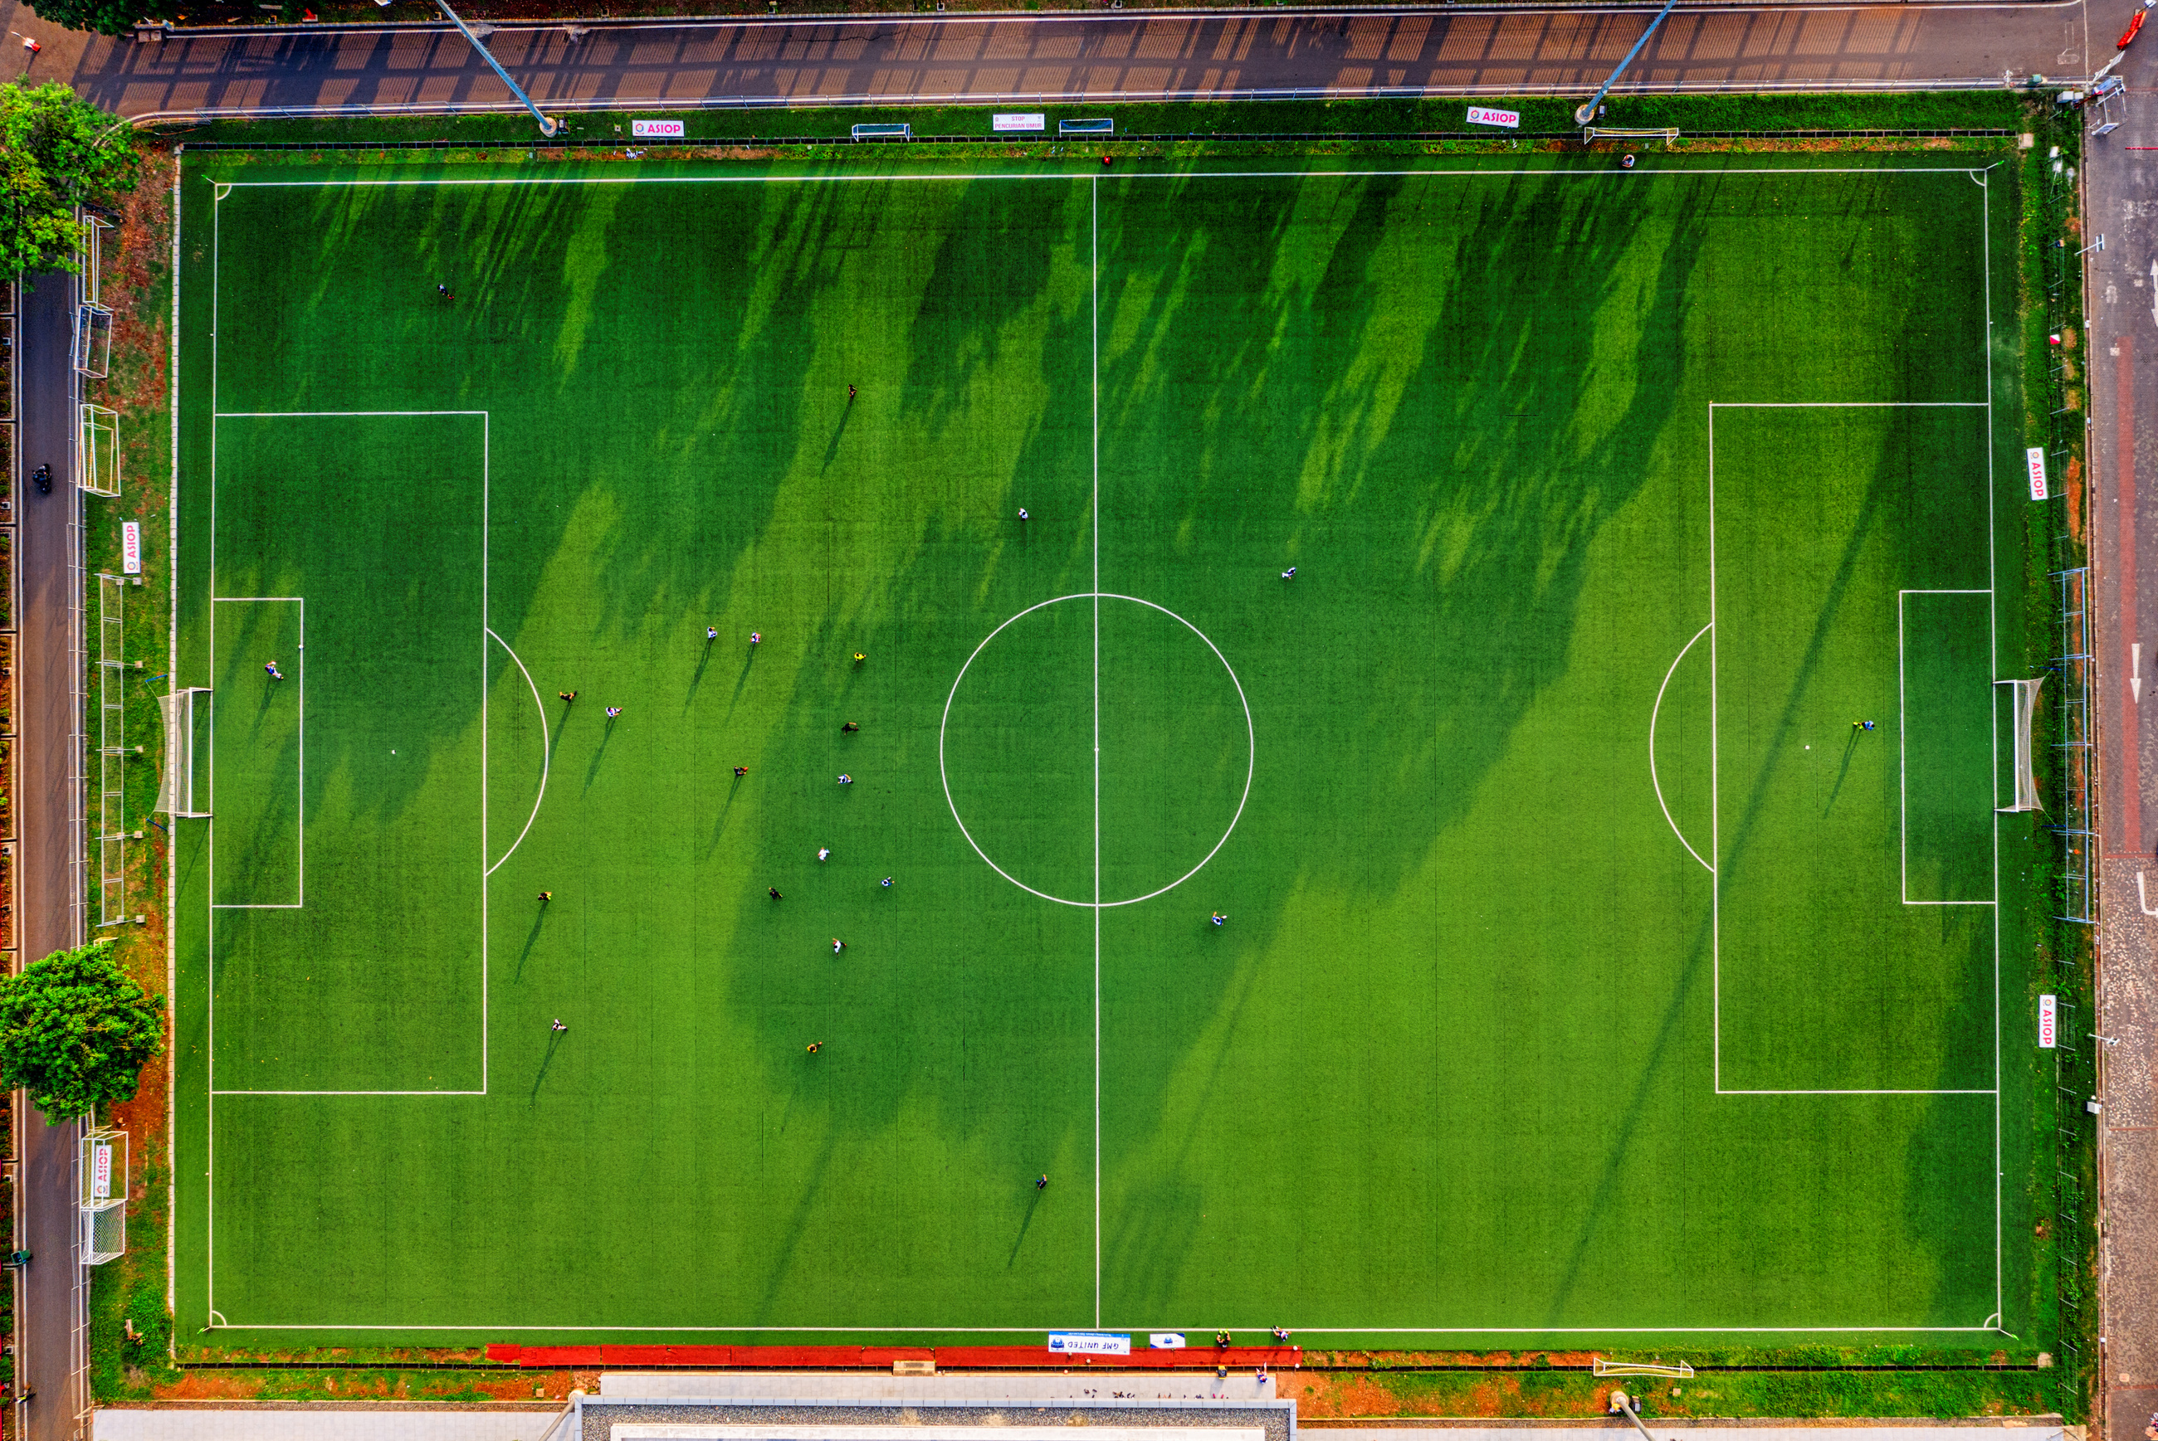
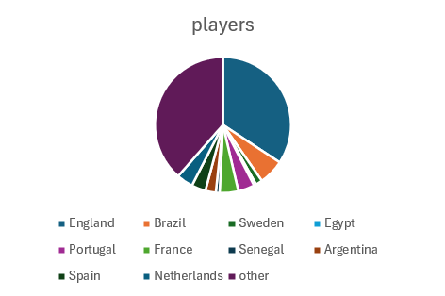
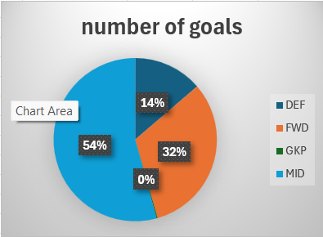
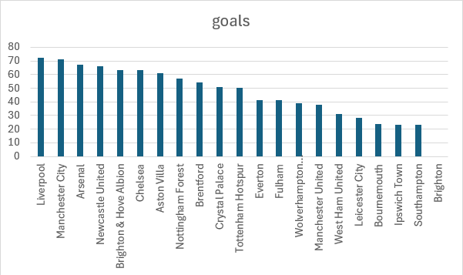

The distribution of players by nationality
This pie chart show that the most common nationality in league is England
The distribution of goal by position
Which club's players have scored the most goals?
This pie chart show that the midfielders has more goals than forwards players
DESCRIPTIVE INSIGHTS

Slide 6
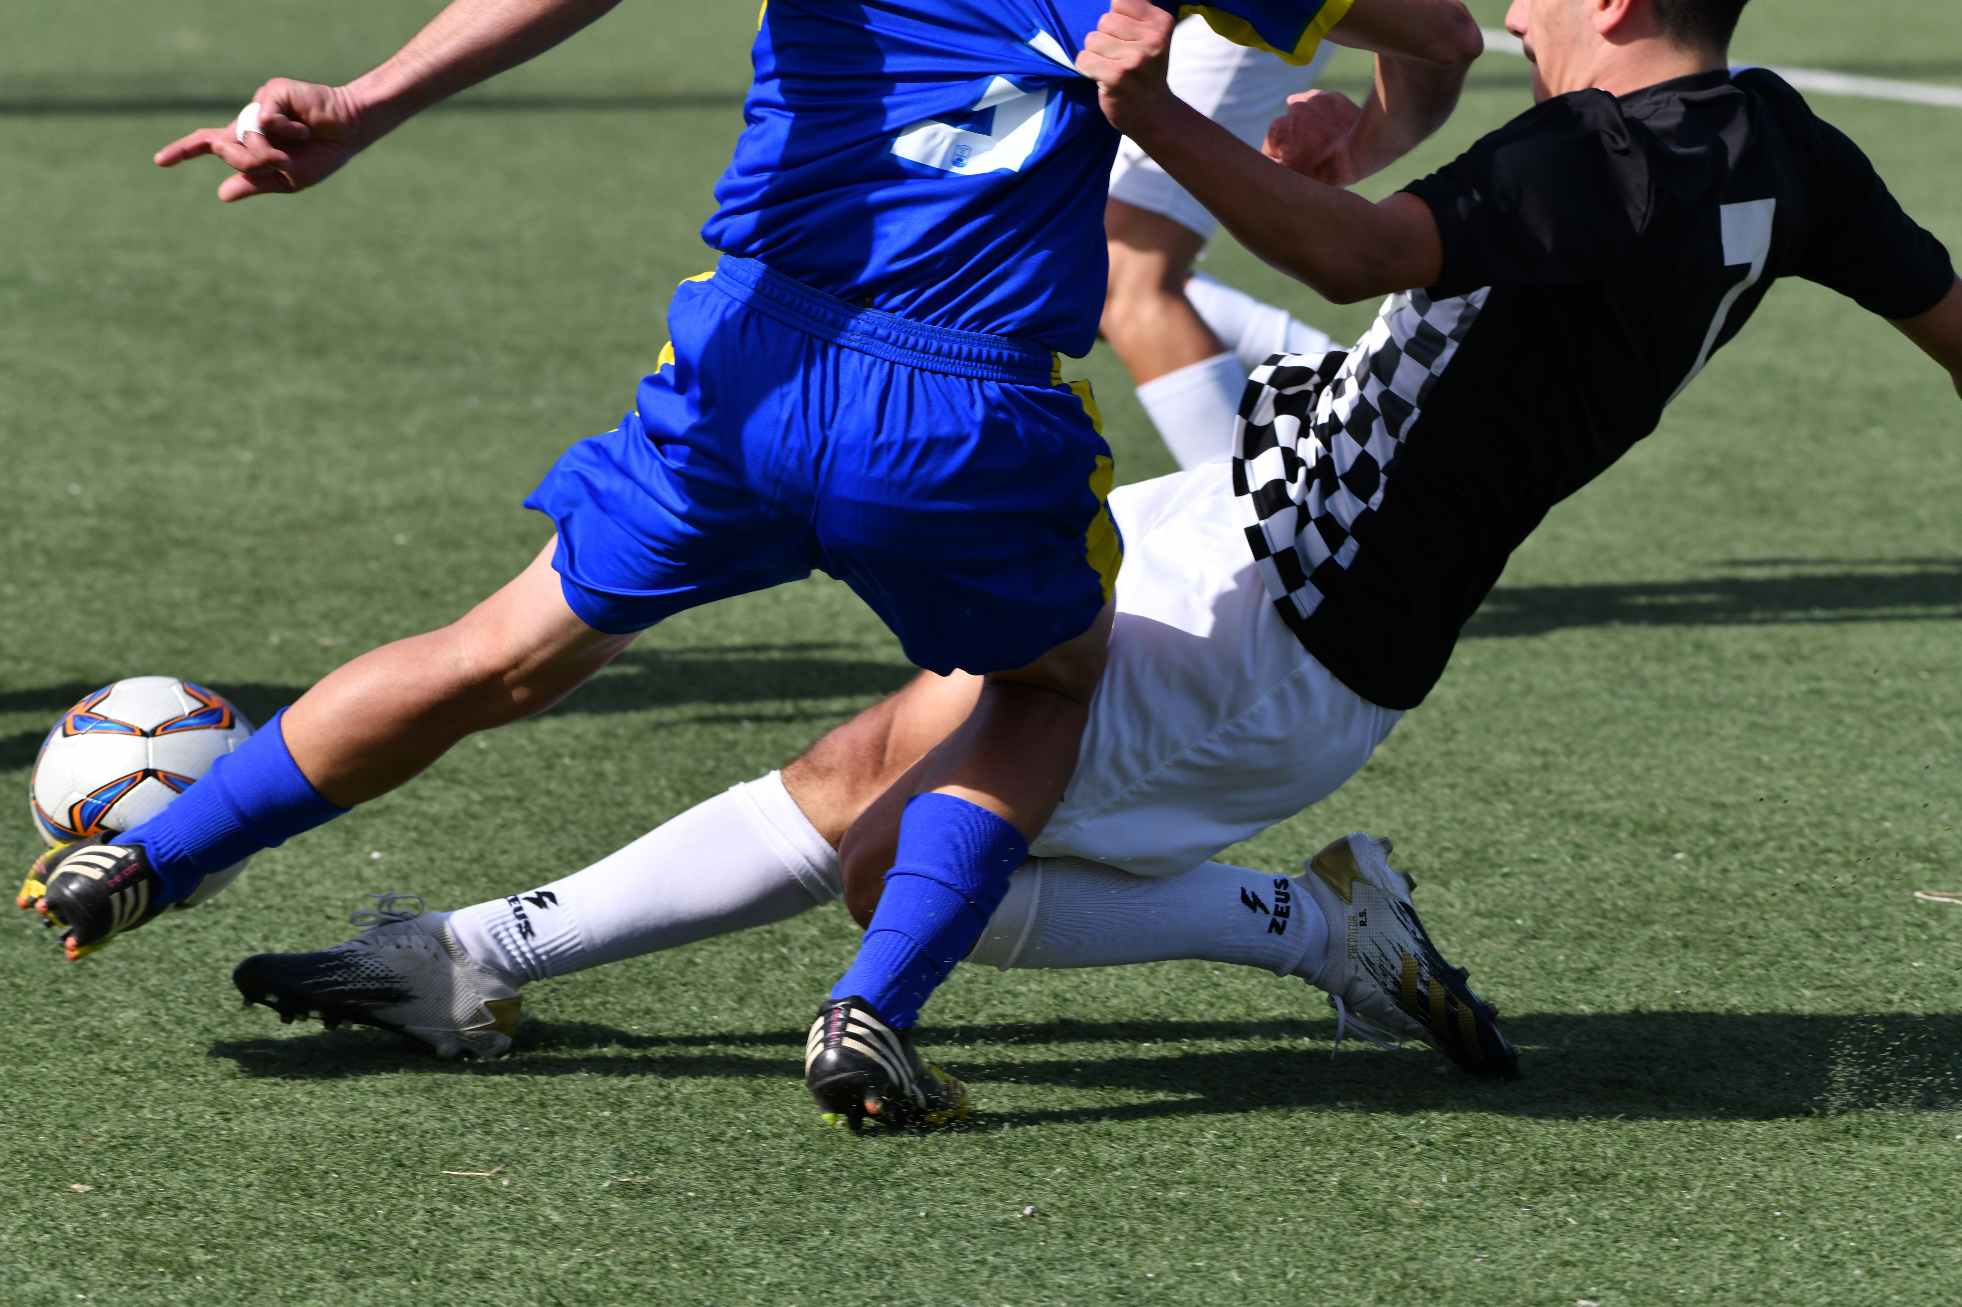
DIAGNOSTIC INSIGHTS
1.Bivariate
Is there a relationship between minutes played and number of goals?
Are final third passes correlated with assists?
Do players with more interceptions have weaker attacking ratings?
Does a player's position affect their pass completion percentage?
Is there a relationship between dispossessions and total passes?
Why do some goalkeepers have higher “Goals Prevented”? Is it linked to save attempts?
Why do some players have a low conversion rate despite taking many shots?
2.Multivariate
Why do some positions score more goals than others? Is it due to the number of shots?
Are tackles and interceptions related based on position?
Is there a relationship between progressive carries and successful dribbles or goals?

Slide 7
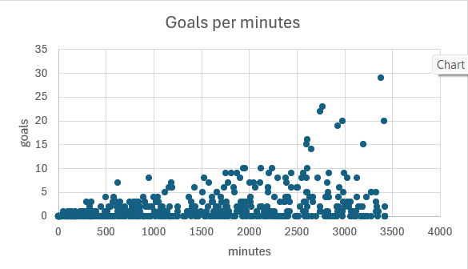
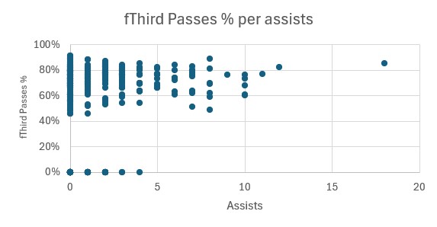
Is there a relationship between minutes played and number of goals?
As we see in the scatter chart there is one side relationship between goals and minutes played, as all top scorers had played more than 2500 minutes but not all players who played more than 2500 minutes are top scorers
Are final third passes correlated with assists?
It is the same conclusion in the goals chart as we see that all top assisters had high final third passes% ,but not all players who had final third passes% are top assisters

Slide 8
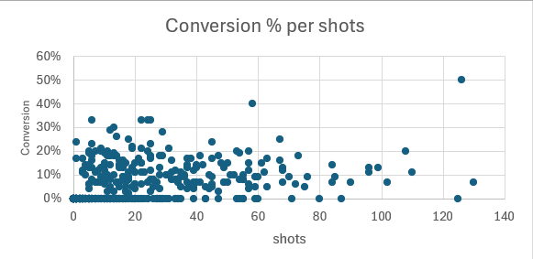
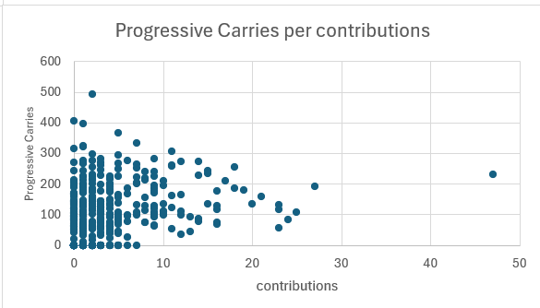
Why do some players have a low conversion rate despite taking many shots?
As we see in the scatter chart there is low average conversion rate, and this may happen because two reasons:
1. low quality of players shots and players
should practice more
2. high quality of goalkeepers and defenders
Is there a relationship between progressive carries and successful dribbles or goals?
As we see in scatter chart there is an inverse relationship between the progressive carries and offensive contribution so we can conclude that the player how make progressive carries usually doesn’t contribute to goals

Slide 9
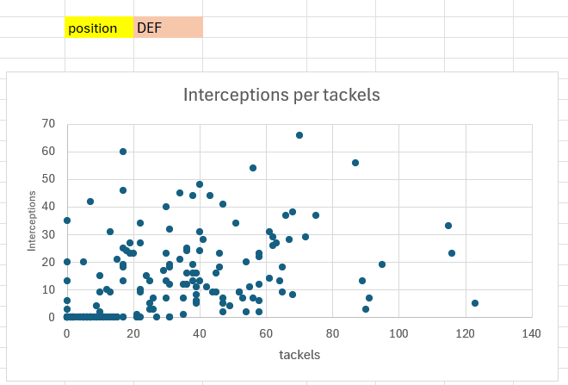
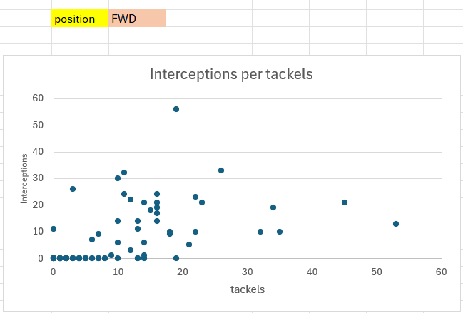
Are tackles and interceptions related based on position?
As we see in scatter chart the number of tackles and interceptions is more in DEF players than FWD players and also the number interception per tackles is more in DEF players as they are specialist in defending

Slide 10



PREDICTIVE MODELING
& PROJECTIONS
1.Bivariate
which player in a selected club is most likely to score?
forecasts the number of goals and assists expected in the next 5 matches.
It predicts which bench players could have a strong impact if given more minutes
2.Multivariate
The system simulates match results between two clubs
combined offensive contribution for an entire team across future matches
how team performance would drop if a key player is unavailable

Slide 11
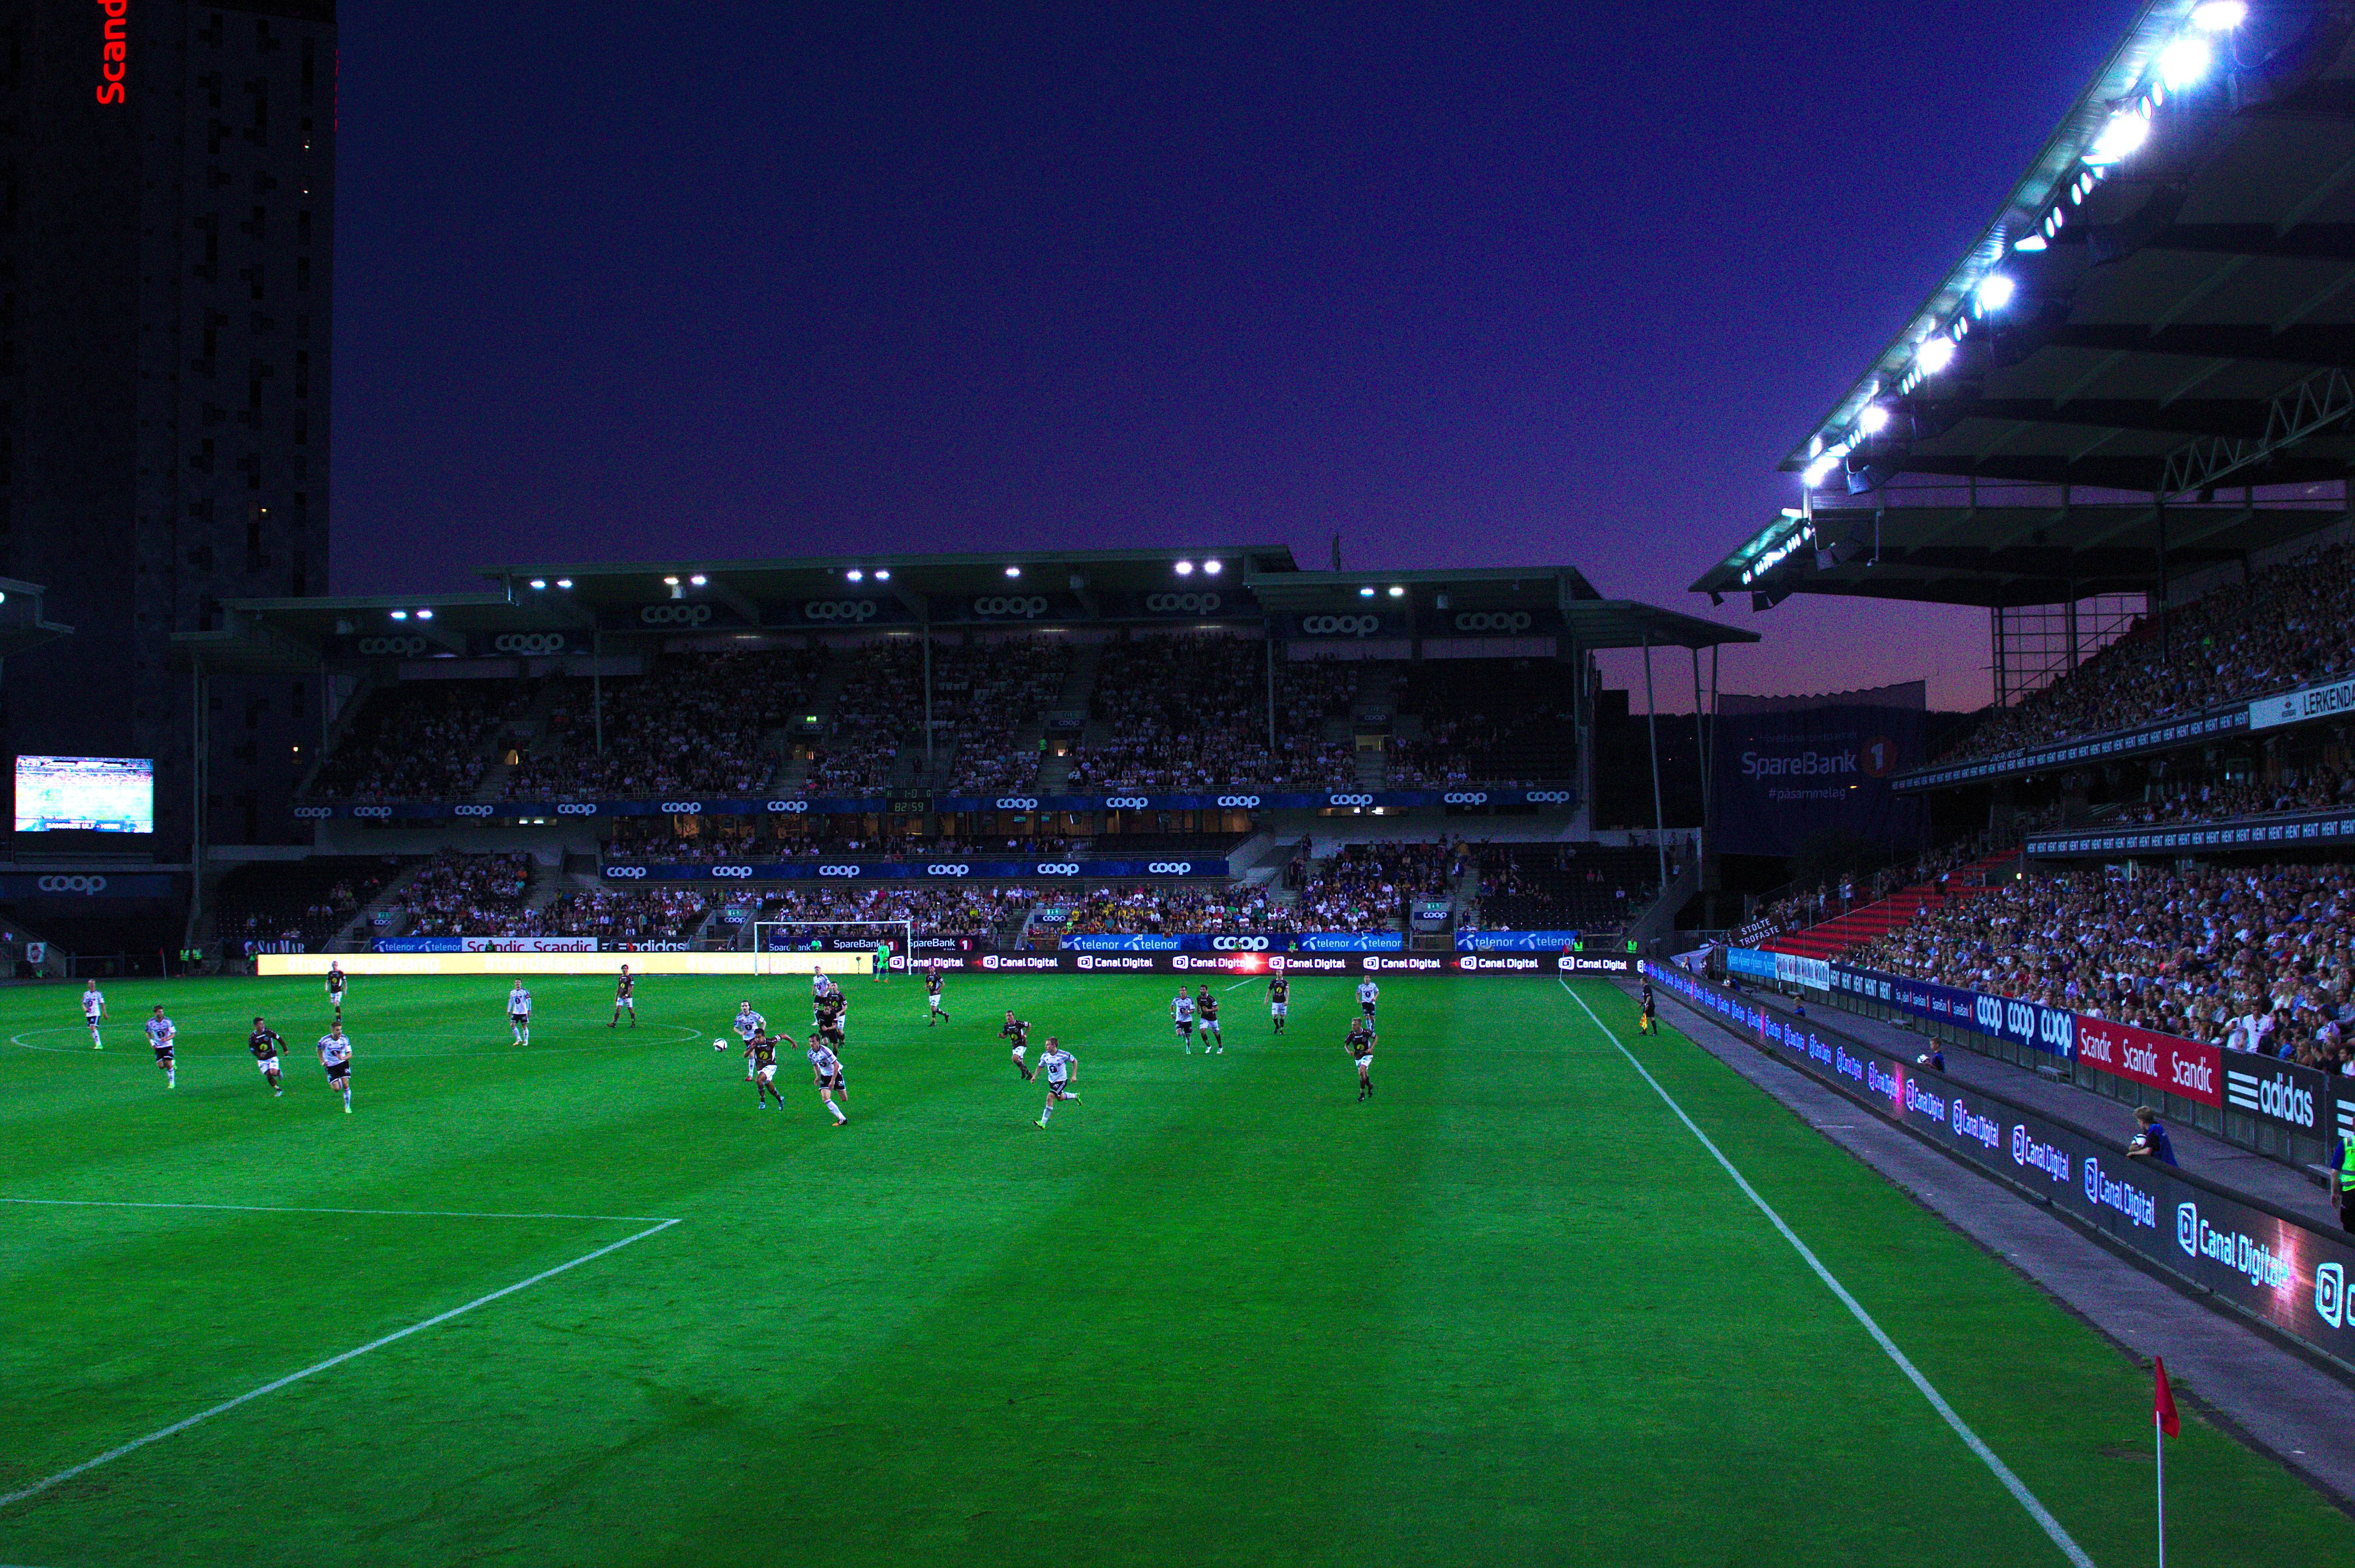
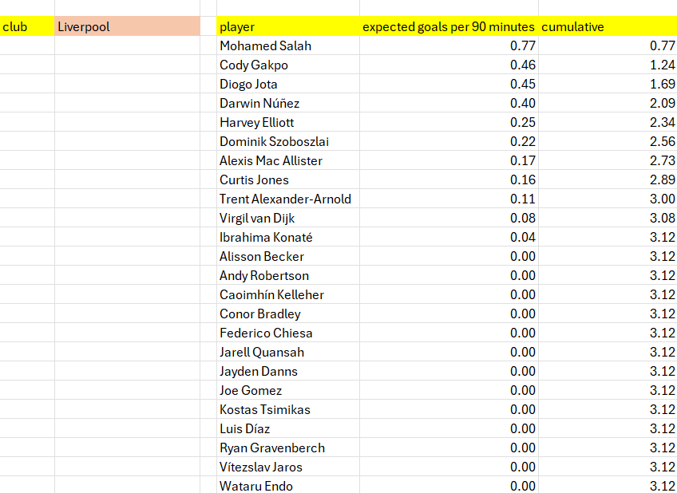
PREDICTIVE MODELING
which player in a selected club is most likely to score?
It predicts which bench players could have a strong impact if given more minutes
This system will predict the number of goals expected for each player and so the number of goals expected per team in next matches by using the cumulative function
how team performance would drop if a key player is unavailable

Slide 12
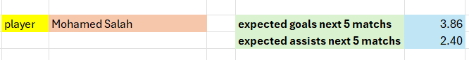
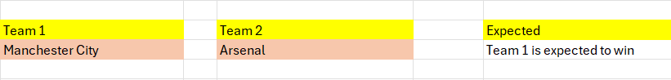
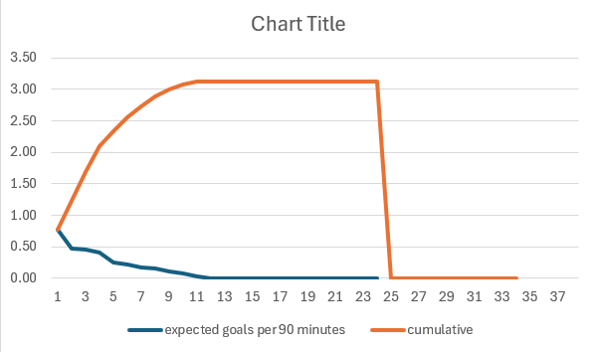
PROJECTIONS
forecasts the number of goals and assists expected in the next 5 matches.
The system simulates match results between two clubs
This chart shows the expected goals per player in next match and the cumulative one shows the expected goals for team in next match
combined offensive contribution for an entire team across future matches

Slide 13

PRESCRIPTIVE RECOMMENDATIONS
1.Bivariate
The system recommends the best starting:
Goalkeeper based on total saves
Defenders based on total clean sheets
Central midfielders based on passing accuracy, key passes
Strikers based on expected goals
optimal lineups for any selected team
The system recommends the best combination of players in each position from selected match

Slide 14

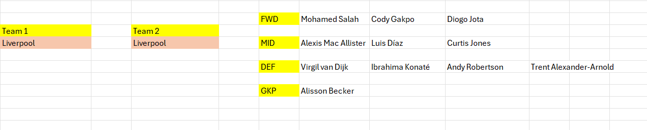
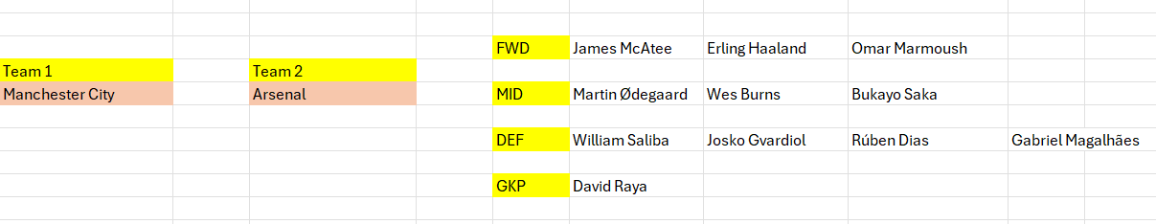
BIVARIATE
RECOMMENDATIONS
The system recommends the best optimal lineups for any selected team
The system recommends the best mixed lineups from selected match

Slide 15
PRESCRIPTIVE RECOMMENDATIONS
2.Multivariate
Smart Scouting & Player Selection System
In the final stage of the analysis, we developed a filter-based recommendation engine to assist:
Clubs in scouting potential signings
National teams in selecting optimal players for call-ups
The system allows filtering players by:
Position
Club
Nationality
Then ranks them based on any selected performance metric such as:
offensive contribution / pass% /clean sheet / saves

Slide 16
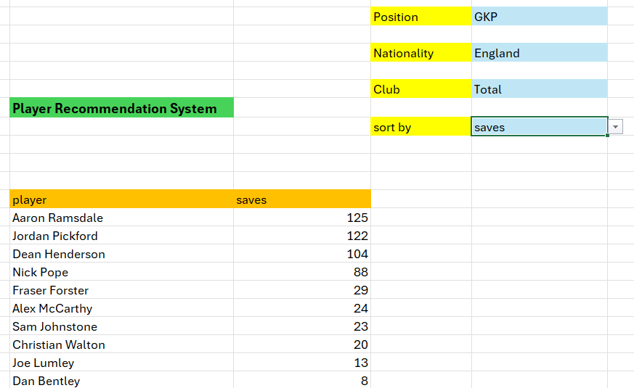
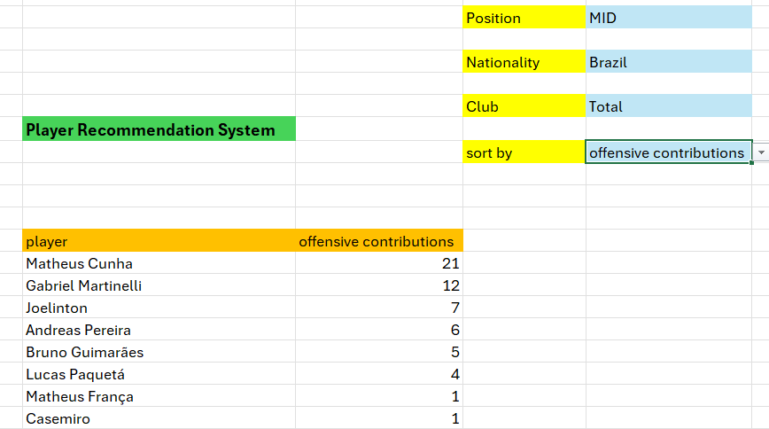
SMART SCOUTING & PLAYER SELECTION SYSTEM
This enables coaches and scouts to make data-informed decisions when:
Identifying high-potential targets
Filling squad gaps
Replacing underperforming players

Slide 17
THANK YOU
By : Mohamed Wahban

